Slide 1
Patient Managment System Project
Student: Eng. Aseel Al-Shadfan MS SQL Development Course Instructor: Eng. Ahmad Batayneh
1

Slide 2
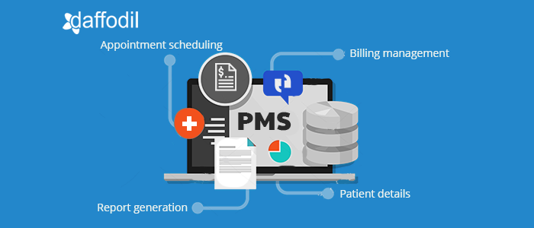
Patient Management System
2

Slide 3
Table of contents
01
02
03
Introduction
Problem statement
Scope
04
05
06
System Design
Reports
Conclusion
3

Slide 4
01
Introduction
Patient Management System
4

Slide 5
Hospitals are very important to society, and healthcare providers need to do their job effectively and efficiently. The number of investments in computers and hospital equipment has increased, but medical records are still on paper, which is cumbersome and difficult to manage, especially when searching for information. PMS is powerful, flexible, and easy to use, and it’s designed and developed to deliver real, conceivable benefits to hospitals.
5

Slide 6

Problem Statement
02
Patient Management System
6

Slide 7
Hospital Problems
Manual handling of the hospital records.
Wrong treatments and bad handwriting cause side effects.
Data redundancy and confusion, as well as difficulty in data retrieval.
A disconnection between healthcare members.
7

Slide 8

03
Scope
Patient Management System
8

Slide 9
Scope
Patient
appointment
scheduling.
Execute
day-to-day operations.
6
1
Paperless hospital of up to 90%.
PMS
Increase connectivity between all healthcare members.
5
2
Billing and report generation
management.
Maintaining patient
details.
4
3
9

Slide 10
04
System Design
Patient Management System
10

Slide 11
E-R Diagram
An entity-relationship diagram (ERD) is an abstract and conceptual representation of data. Entity-relations modeling is a database modeling method used to produce a type of conceptual schema or semantic data model of a system.
11

Slide 12
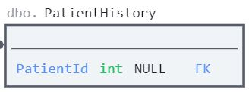
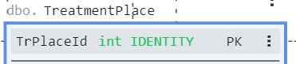
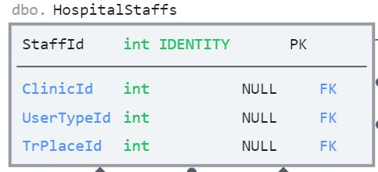
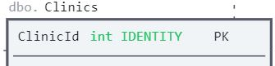
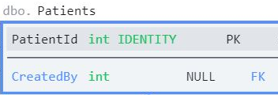
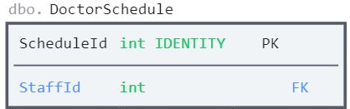
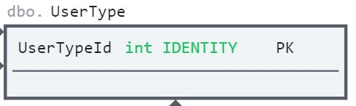
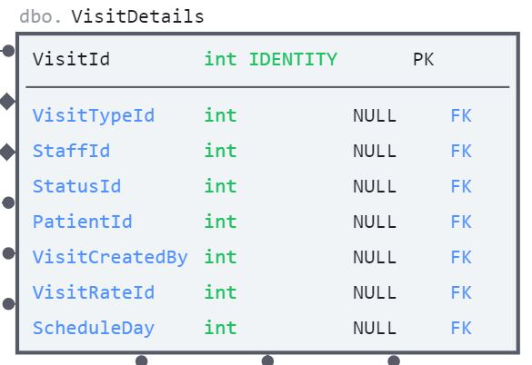

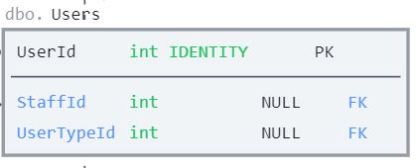
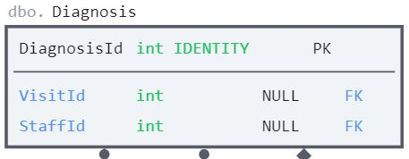
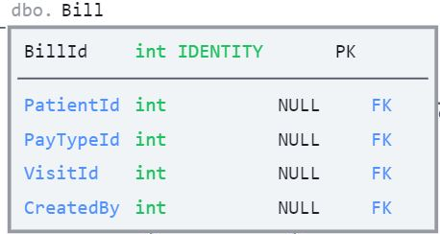
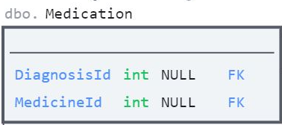
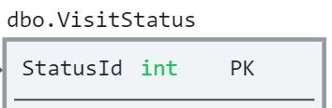
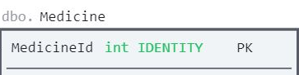
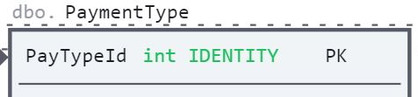
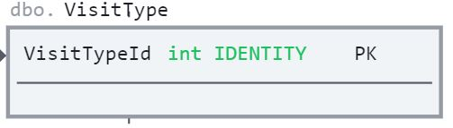
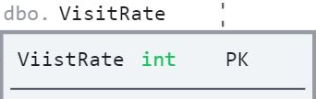
ER DIAGRAM
12

Slide 13
PMS Reports
05
Patient Management System
13

Slide 14
Report (1)
ID | Patient Name | Created By | User Type | Address | Contact No | DOB | Age | Gender | National No | Blood Group | Email | Relative Name | Relative Contact | Marital Status | Is Active
1 | Sarah Malkawi | Sarah Malkawi | Patient | Amman | 962111111111 | 1/1/1994 | 28 | F | 111111111 | A | Sarah@Patient.com | Ahamd Malkawi | 962969962961 | Single | True
2 | Shahed Ahmad | Shahed Ahmad | Patient | Amman -Marka | 962222222222 | 7/5/1982 | 40 | F | 111111112 | O | Shahad@Patient.co m | Salim Ahamd | 962969962964 | Married | True
3 | Mohammad Kamal | Mohammad Kamal | Patient | Jarash | 962333333333 | 10/15/1992 | 30 | M | 111111113 | A+ | Mohammed@Patiet. com | Marwa Kamal | 962969962966 | Married | True
4 | Saleem Alfaqeeh | Saleem Alfaqeeh | Patient | Irbid | 962444444444 | 1/3/2002 | 20 | M | 111111111 | B | Saleem@Patient.com | Amneh Alfqeeh | 962969962968 | Single | True
5 | Israa Naeem | Israa Naeem | Patient | Amman -Jubiha | 962555555555 | 12/31/2021 | 1 | F | 111111111 | B | Israa@Patient.com | Essam Naeem | 962969962910 | Single | True
6 | Fatmeh Ahmad | Amjad Saleem | Receptionist | Amman -Marka | 962666666666 | 12/2/1977 | 45 | F | 111111111 | B | Fatmeh@Patient.com | Faris Ahmad | 962969962912 | Married | True
7 | Saleh Alsyouf | Ahmad Mohammed | Receptionist | Amman -Jubiha | 962777777777 | 6/3/1967 | 55 | M | 111111111 | O | Saleh@Patient.com | Hamza Alsyouf | 962969962914 | Married | True
8 | Qusai Aljamal | Ahmad Mohammed | Receptionist | Amman | 96288888888 | 12/5/2005 | 17 | M | 111111111 | AB+ | Qusai@Patient.com | Usaid Aljamal | 962969962916 | Single | True
9 | Jaber Odeh | Amjad Saleem | Receptionist | Irbid | 962999999999 | 4/13/2012 | 10 | M | 111111111 | AB+ | Jaber@Patient.com | Shadi Odeh | 962969962918 | Single | True
10 | Samah Alissa | Ahmad Mohammed | Receptionist | Amman -Jubiha | 962111111112 | 8/15/1947 | 75 | F | 111111112 | A | Samah@Patient.co m | Tuqa Alissa | 962969962920 | Married | True
Get all patient information report.
14

Slide 15
Report (2.a)
Patient Name | User Name | Doctor Name | Patient Id | Age | Created By | Visit Id | Clinic | Booked Day | Visit Type | Visit Rate | Status | Diagnosis | Treatment Place
Sarah Malkawi | Amjad Saleem | Shadi Alzgoul | 1 | 28 | Receptionist | 18 | Emergency | - | IN | Good | - | Check blood pressure and diabetes | Emergency
 | Sarah Malkawi | Manal Khaled |  |  | Patient | 1 | Dentistry | Saturday | OUT | Good | Booked | Gingivitis | Clinic
 |  | Musaab Naji |  |  |  | 16 | Dermatology | Thursday |  | Very Good |  | Iritic
 |  | Sultan Alsyouf |  |  |  | 17 | Obstetrics and Gynecology | Wednesday |  | Helpful |  | Sudden, severe abdominal or pelvic pain
 |  | Usaid Jamal |  |  |  | 11 | Otolaryngology | Monday |  | Very Good |  | Inflammation of the middle ear
Patient with Id = 1 visit history.
15

Slide 16
Report (2.B)
Patient Name | User Name | Doctor Name | Patient Id | Age | Visit Id | Created By | Clinic | Booked Day | Visit Type | Visit Rate | Status | Diagnosis | Treatment Place
سماح العيسى | أحمد محمد | شادي الزغول | 10 | 75 | 10 | Receptionist | Emergency | - | IN | Good | - | shortness of breath – dyspnea | Emergency
 |  | مجاهد العمري |  |  | 19 |  |  |  |  | Bad |  | Paranasal sinuses
 | أمجد سليم | شادي الزغول |  |  | 20 |  |  |  |  | Helpful |  | Severe hypoglycemia
 |  | مجاهد العمري |  |  | 21 |  |  |  |  | Good |  | Dry eyes, increased tearing
 |  |  |  |  | 22 |  |  |  |  | Good |  | Reduction of Blood pressure
Patient with Id = 10 visit history.
16

Slide 17
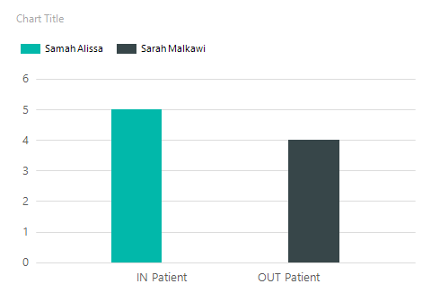
Report (3)
Visit Count | Patient Id | Patient Name | Visit Type
4 | 1 | Sarah Malkawi | OUT Patient
5 | 10 | Samah Alissa | IN Patient
Most frequent inpatient and outpatient visits.
17

Slide 18
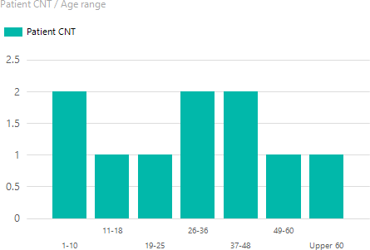
Report (4)
Report (4)
Patient CNT | Age Range
2 | 1-10
1 | 11-18
1 | 19-25
2 | 26-36
2 | 37-48
1 | 49-60
1 | Upper 60
The total number of patients is divided by their age.
18

Slide 19
06
Conclusion
Patient Management System
19

Slide 20
Patient Management System
01
02
03
The system provides easy and effective storage of information related to patients that come up to the hospital.
The system
generate reports and provides the facility for searching the details of the patient.
The digitization
of the system
has speeded up the process.
20

Slide 21
Thanks!
Do you have any questions?
Email: aseelshdfan@gmail.com.
Al Hussein Technical University
21

